Slide 1

Express.js serverio
kūrimas (2)
Dėstytojas
2 LYGIS
3 DALIS
Node.js

Slide 2
Šiandien išmoksite
JavaScript programavimo kalba
01
Express.js (routes) maršrutai (2)
02
Express.js (middleware) tarpininkai

Slide 3
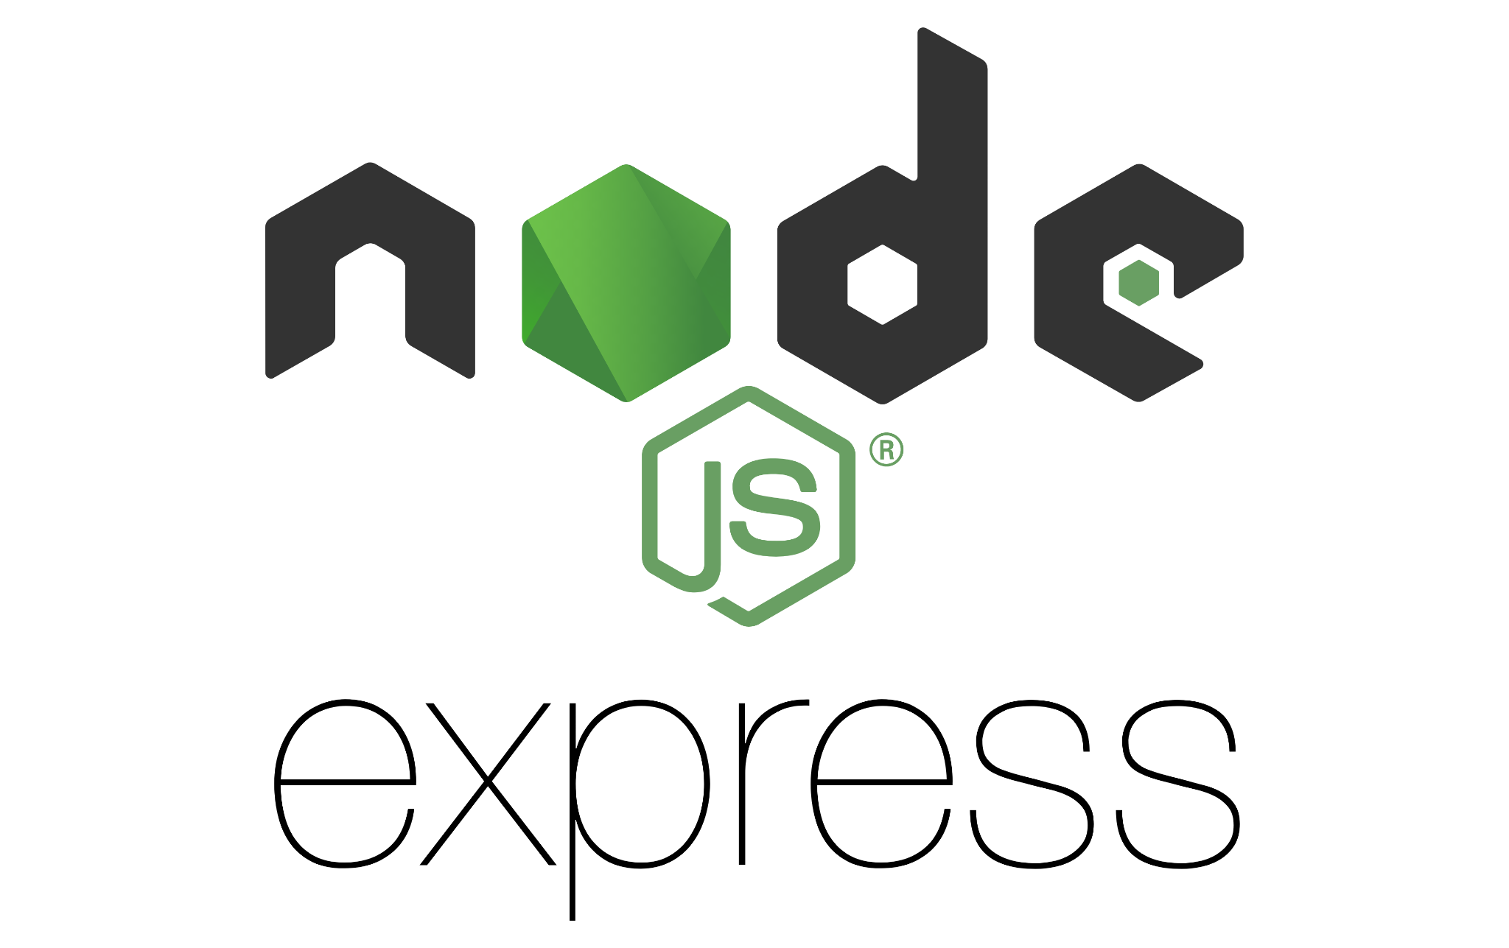
Express.js (routes) maršrutai
Node.js
Routing refers to determining how an application responds to a client request to a particular endpoint, which is a URI (or path) and a specific HTTP request method (GET, POST, and so on). - Expressjs docs
Apžvelkime detaliau šias temas:
Route methods
Route paths
Route parameters
Route handlers
Response methods
express.Router
Docs (lets follow guide): https://expressjs.com/en/guide/routing.html

Slide 4
Express.js (middleware) tarpininkas
Node.js
Middleware functions are functions that have access to the request object (req), the response object (res), and the next function in the application’s request-response cycle. - Expressjs docs
Express.js (middleware) kūrimas - https://expressjs.com/en/guide/writing-middleware.html
Express.js (middleware) naudojimas - https://expressjs.com/en/guide/using-middleware.html

Slide 5
Node.js
Užduotis nr. 1
Sukurkite savo express.js serverį, kuris atkurks https://jsonplaceholder.typicode.com/ pateikiamą logiką su https://jsonplaceholder.typicode.com/posts maršrutu. GET /posts - grąžins posts
GET /posts/1 - grąžins vieną post pagal id parametrą
GET /posts?title=randomTitle - grąžins vieną post pagal title nurodtą query vertę (jei neras, grąžins tuščią objektą)
POST /posts - sukurs įrašą
PUT /posts/1 - atnaujins įrašą pagal id
DELETE /posts/1 - panaikins įrašą pagal id
Papildoma informacija:
post struktūra: {
title: string
id: number
body: string
}
turėkite minimum 3 posts testavimui

Slide 6
Naudinga informacija
Node.js
Informacija
https://expressjs.com/en/guide/routing.html
https://expressjs.com/en/guide/writing-middleware.html
https://expressjs.com/en/guide/using-middleware.html

